Slide 1
貪食蛇pk
物聯網應用設計與實作期末專題
0616243
0616030
0510175
0416313
0316045
0316032

Slide 2
遊戲規則
2 players, initial length 20
1 ball, randomly generate
Touch blue ball, length increase 1
Touch Red ball can let you speedup
Touch the other one, you dead
If one player die, you can press any key to restart

Slide 3
DEMO

Slide 4
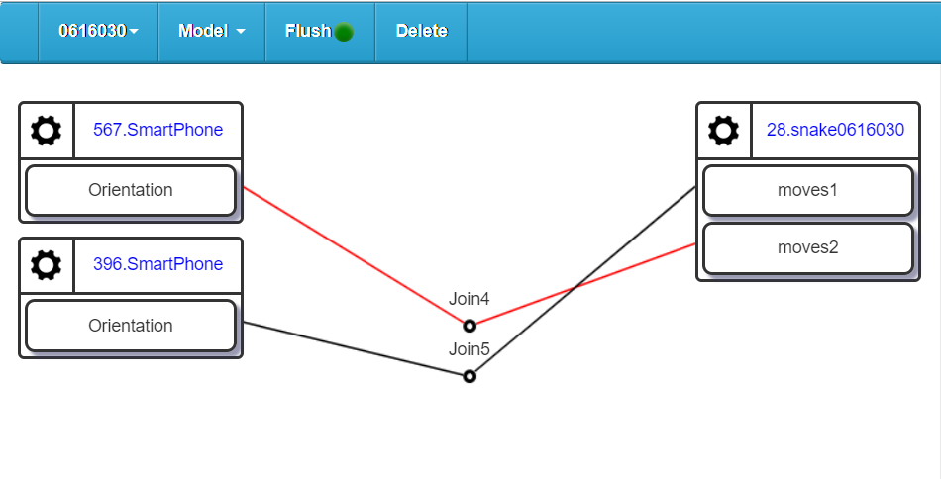

Slide 5
功能/分工
Snake Generation: 王鵬瑋 (16.6%)
First Edition: 黃郁仁 (16.6%)
Collision detection: 邱羿雲 (16.6%)
Input control: 賴政毅 (16.6%)
Debugger: 李惠怡 (16.6%)
Chief editor: 何元斌 (16.6%)

